Slide 1

Does Tottenham have what it takes? (Yes)
James Zhou
Capstone

Slide 2
Contents
Introduction
Obtaining the data
Assumptions and plan
The story
The modelling
Live demo
Findings and improvements

Slide 3
Introduction
Many football clubs invest in youth development and sign young players in an attempt to ‘profit’ off the player. From a case study, Brentford have been successful in their approach. Can Tottenham do the same?
The goal of the Capstone is to produce a model that can accurately predict player market values using actual data from Transfermarkt and data scrapped from FIFA 23.

Slide 4
Resources
Transmarkt dataset – Kaggle
FIFA 23 dataset – FIFA index
Market value prediction using FIFA 21 data - https://towardsdatascience.com/predicting-market-value-of-fifa-soccer-players-with-regression-5d79aed207d9
Market value prediction using FIFA 20 data -https://ieeexplore.ieee.org/stamp/stamp.jsp?arnumber=9721908

Slide 5
Getting the final dataset
Transmarkt
FIFA 23
Final dataset
To obtain the final dataset, I did a join on the name column of each datasets I had. This required:
Changing accents
Matching names

Slide 6
Assumptions
FIFA 23 data is realistic
FIFA 23 data does not use market value as one of their features in predicting player potentials
All players are evaluated on the same criterions
There are no errors in the data from the original source

Slide 7
The plan
Linear regression is a linear model that will be used in modelling the market value. I expect to go through the usual cycle of data project lifecycle.
The success of this Capstone will be determined by the RMSE, which is a metric that measures error. As market values are in the millions, the benchmark of this Capstone is 10million.

Slide 8
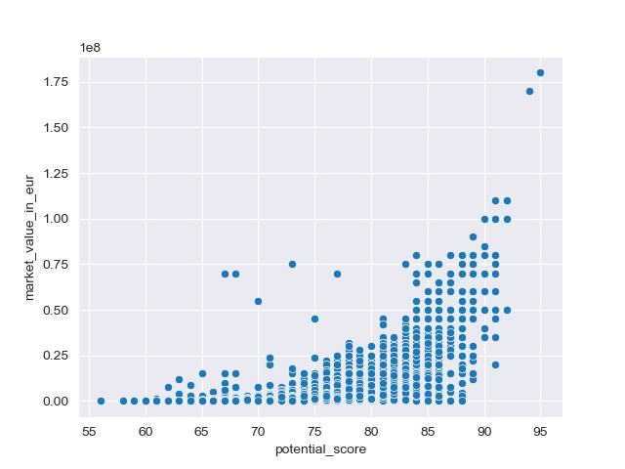
The story
Here we see an exponential growth.
This is realistic, as players like Mbappe and Haaland have been rated at extremely high market values compared to others.
Hence, age heavily influences market values.

Slide 9
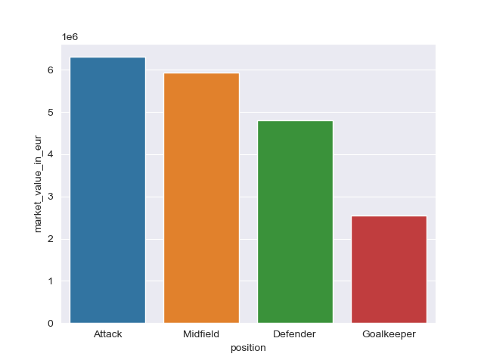
The story
There are many positions in football.
Forwards are usually the ones that score goals and make the headlines which leads to a higher market value.
Often, there are less demand for goalkeepers.

Slide 10
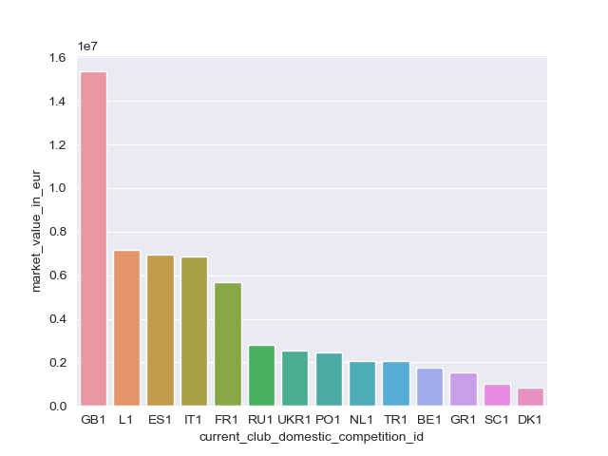
The story
There are different levels of investment into each league.
The Premier League (GB1) is one of the most competitive football leagues and level of players are much higher.
Often, world class players are found in the top 5 leagues.

Slide 11
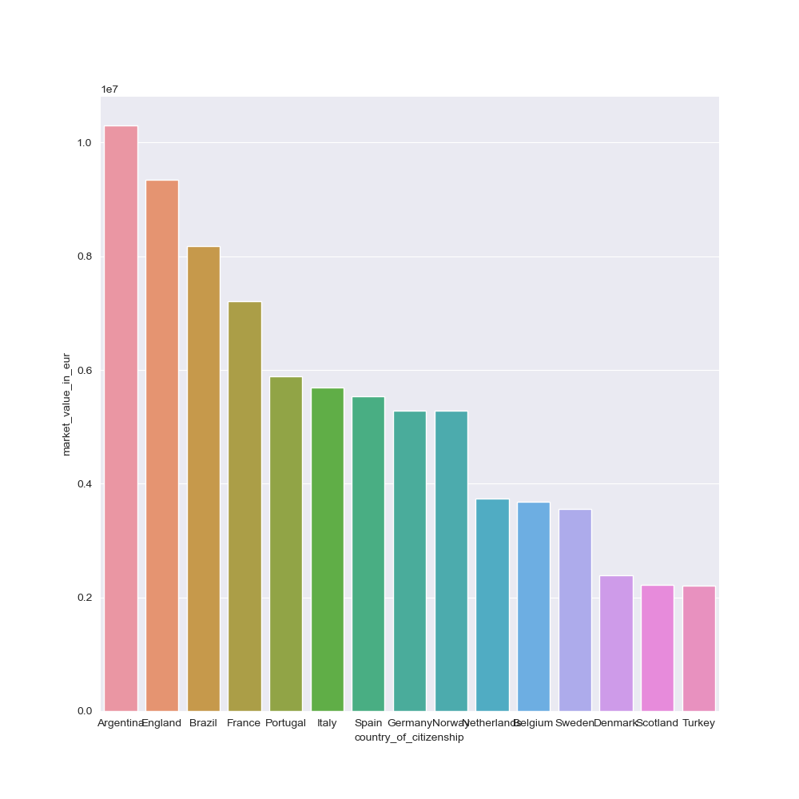
The story
Top footballing nations often have world class youth academies.
Argentina winning the world cup lead to a spike in market value.
No surprise that England is second, since its level of investment is at the top.

Slide 12
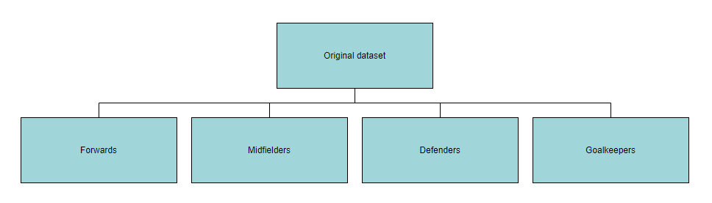
Modelling
RMSE for train (forwards) | 10387542.72
RMSE for test (forwards) | 7008301.12
Here we have an issue of underfitting, where the model does not do well on training set and testing set.

Slide 13
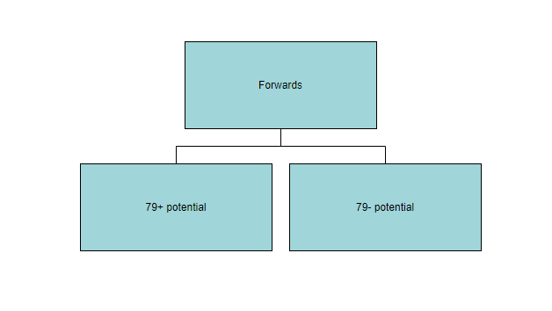
Modelling
The value of 79 comes from the upper quartile of the forwards dataset when ordered by potential score.
For this model, I also ran Lasso, ElasticNet and Ridge regression which are different regularisation techniques. I also ran Gridsearch in order to find the optimal hyperparameters.

Slide 14
Modelling
ElasticNet RMSE for train (79+) | 9697886.11
ElasticNet RMSE for test (79+) | 7574165.39
Ridge RMSE for train (79-) | 2256893.53
Ridge RMSE for test (79-) | 4512131.05
For the 79+ potential set, we have an underfitting model while for the 79- potential set, we have an overfitting model.
These can be explained by the outliers in each set and the train test split may have split the data in a way that the outliers are mainly in the train set or the outliers are mainly in the test set.

Slide 15
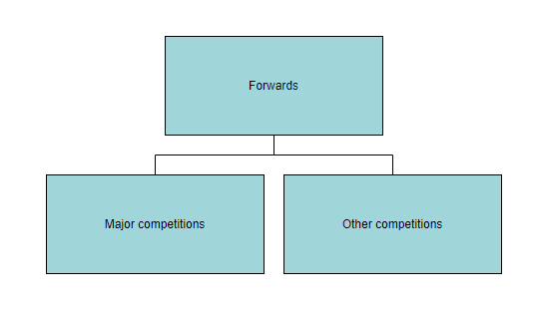
Modelling
Recall from earlier the top 5 competitions. We would expect players that are in these leagues are of similar market value.
Lasso RMSE for train (major) | 7883620.46
Lasso RMSE for test (major) | 9099924.34
Ridge RMSE for train (other) | 2372987.91
Ridge RMSE for test (other) | 2019084.66

Slide 16
Live Demo

Slide 17
Findings and further improvements
Footballer values generally have extreme outliers that can be hard to model, leading to underfit or overfit models.
Improvements:
Having latest scores and stats
Performances in past seasons
Media influence and reputation

Slide 18
Thank you for listening
Questions?

